Slide 1
[Organisation] · PHASE C
Application Portfolio
Catalogue
Twenty-six applications scored on business value and technical fitness, and the six where the recorded disposition disagrees
R320.5m annual run cost · 5 Invest · 12 Tolerate · 3 Migrate · 1 Eliminate
0.1 — Draft · September 2027

Slide 2
METHOD
How the position is derived
Both scores are computed from the repository. The rules are stated so the result can be argued with; a score you cannot argue with is a score nobody uses.
Business value
How much of the business depends on it.
Criticality tier, capabilities supported, business services implemented, information system services provided, and users.
An application supporting many capabilities for many users is worth more than one supporting few, whatever it costs.
Technical fitness
How well it can carry what depends on it.
Lifecycle, age since it went live, interface count, and hosting.
Age alone is not the test. A twenty-year-old system with three interfaces is easier to change than a five-year-old one with fourteen.
Quadrant
Where the two scores place it.
Invest, Tolerate, Migrate or Eliminate, on the standard two-by-two.
This is a position, not a decision. The decision is the recorded disposition, and where the two disagree that is worth a conversation.
What is not scored
Cost.
Cost appears in the catalogue and does not move the position.
A cheap application that nothing depends on is still a candidate for elimination, and an expensive one the business runs on is still an investment.
Cost is in the catalogue and does not move the position. A portfolio ranked by cost optimises the wrong thing.

Slide 3
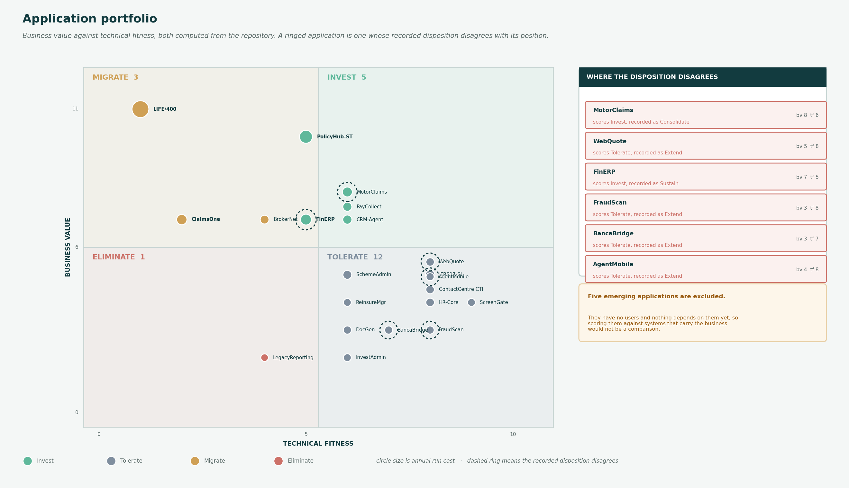
PORTFOLIO
Business value against technical fitness
Circle size is annual run cost. A dashed ring means the recorded disposition disagrees with the derived position.

Slide 4
THE CATALOGUE
Twenty-six applications
Scored on business value and technical fitness. Five emerging applications are excluded from the position.
Application
Crit
Lifecycle
Age
Users
Cost
Caps
Ifc
BV
TF
Quadrant
Disposition
LIFE/400
T1
Legacy
33
1,800
R68.4
18
11
11
1
Migrate
Replace
PolicyHub-ST
T1
Current
8
1,400
R41.2
23
14
10
5
Invest
Extend
ClaimsOne
T1
Legacy
29
620
R22.6
6
4
7
2
Migrate
Consolidate
MotorClaims
T1
Current
8
740
R19.8
13
4
8
6
Invest
Consolidate
CRM-Agent
T2
Current
10
1,950
R14.3
7
4
7
6
Invest
Extend
BrokerNet
T1
Legacy
14
3,400
R11.7
5
3
7
4
Migrate
Replace
WebQuote
T1
Current
6
0
R8.9
5
3
5
8
Tolerate
Extend
ContactCentre CTI
T1
Current
7
610
R9.4
1
2
4
8
Tolerate
Sustain
SchemeAdmin
T1
Current
12
290
R12.1
6
3
5
6
Tolerate
Sustain
InvestAdmin
T2
Current
11
70
R5.2
1
1
2
6
Tolerate
Sustain
FinERP
T1
Current
5
540
R26.4
13
11
7
5
Invest
Sustain
IFRS17-SL
T1
Current
4
86
R15.8
6
3
5
8
Tolerate
Sustain
DocGen
T2
Current
9
120
R7.3
3
6
3
6
Tolerate
Sustain
PayCollect
T1
Current
9
190
R13.6
11
5
7
6
Invest
Extend
FraudScan
T2
Current
6
140
R6.8
2
2
3
8
Tolerate
Extend
ReinsureMgr
T2
Current
10
44
R4.9
7
3
4
6
Tolerate
Sustain
ScreenGate
T1
Current
4
210
R5.6
4
3
4
9
Tolerate
Sustain
BancaBridge
T1
Current
6
60
R7.1
1
3
3
7
Tolerate
Extend
HR-Core
T2
Current
7
4,200
R9.8
4
2
4
8
Tolerate
Sustain
API Gateway
T1
Emerging
0
0
R0
3
3
3
10
Tolerate
Build
CustomerHub
T1
Emerging
—
0
R0
6
1
5
10
Tolerate
Build
Enterprise Data Platform
T1
Emerging
—
0
R0
20
3
6
10
Invest
Build
ProductStudio
T1
Emerging
—
0
R0
2
1
4
10
Tolerate
Build
ModelOps
T2
Emerging
—
0
R0
3
1
2
10
Tolerate
Build
LegacyReporting
T3
Legacy
19
380
R3.2
8
2
2
4
Eliminate
Retire
AgentMobile
T2
Current
5
1,900
R6.4
3
2
4
8
Tolerate
Extend
Pink rows are the six where the recorded disposition does not match the derived position.

Slide 5
DISAGREEMENTS
Six dispositions do not match the position
Disagreement is not error. The disposition may reflect a contract or a dependency the scoring cannot see. None of the six currently has an explanation in the roadmap.
MotorClaims
bv 8 · tf 6
scores Invest
recorded Consolidate
Recorded as Consolidate with ClaimsOne. If MotorClaims is the consolidation target, the disposition should say so.
WebQuote
bv 5 · tf 8
scores Tolerate
recorded Extend
Scores Tolerate because no users are recorded against it. If the user count is wrong, the position is wrong.
FinERP
bv 7 · tf 5
scores Invest
recorded Sustain
Eleven interfaces and thirteen capabilities. An application with eleven interfaces is not being sustained; it is being depended on.
FraudScan
bv 3 · tf 8
scores Tolerate
recorded Extend
Two capabilities and 140 users, recorded as Extend. Worth confirming what the extension is for.
BancaBridge
bv 3 · tf 7
scores Tolerate
recorded Extend
One capability, recorded as Extend. The partner channel may justify it; the capability model does not show why.
AgentMobile
bv 4 · tf 8
scores Tolerate
recorded Extend
Three capabilities against 1,900 users. Either the capability mapping is thin or the disposition is optimistic.
LIFE/400 scores Migrate and is recorded as Replace, which the scoring accepts. Replace implies a successor exists; no work package replaces it.

Slide 6
FINDINGS
What the portfolio shows
Six applications sit where their recorded disposition does not put them
The derived quadrant and the disposition in O23 disagree for six of twenty-six.
Disagreement is not error. The disposition may reflect a contract, a dependency or a decision the scoring cannot see. Each of the six is worth a sentence of explanation in the roadmap, and none currently has one.
The two highest business-value applications are the two that constrain everything
LIFE/400 scores 11 and PolicyHub-ST 10. Between them: 41 capabilities, 3,200 users, 25 interfaces and R109.6m a year.
LIFE/400 scores 1 on technical fitness and PolicyHub-ST 5. The estate depends most on the two systems least able to carry it, and nothing can be changed around either without touching it.
LIFE/400 is the clearest Migrate and is recorded as Replace
Eighteen capabilities, 1,800 users, R68.4m a year, live since 1994, eleven interfaces, mainframe.
Replace and Migrate are not the same decision. Replace implies a successor exists; the roadmap has no work package that replaces LIFE/400, and the Statement of Architecture Work explicitly excludes it.
The five emerging applications score zero on business value
API Gateway, CustomerHub, Enterprise Data Platform, ProductStudio, ModelOps: no users, no live services, nothing depending on them yet.
That is correct and it makes the quadrant meaningless for them. They are excluded from the disagreement count, because scoring something that does not exist against something that does is not a comparison.
Cost does not correlate with business value
FinERP costs R26.4m for 540 users; HR-Core costs R9.8m for 4,200. LegacyReporting costs R3.2m and supports eight capabilities.
Cost is in the catalogue and does not move the position, deliberately. A portfolio ranked by cost optimises the wrong thing, and LegacyReporting is the case in point: cheap, still used, and the only application anyone has agreed to retire.
The estate depends most on the two applications least able to carry it, and neither can be changed without touching the other.

